Slide 1

C PER
Center for Advanced Power Engineering Research
Presented By:
Morey Agnew
Clemson University

Slide 2
Datasets Used
List of Substations
This excel file has all the substations in the area but we only used Distribution type substations
Interconnection Request
This excel file has all of the interconnection request but we are only interested in Distribution and Solar type requests that are in the Carolinas.
To make the GIS maps we used a function inside the Sandia National Lab.

Slide 3
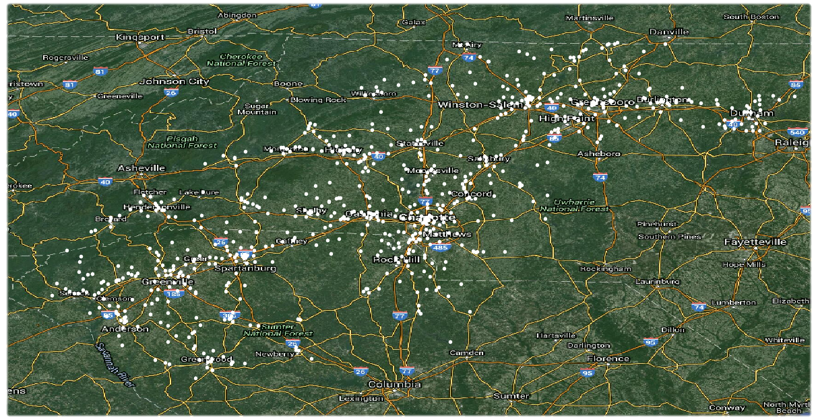
Distribution Substation Locations

Slide 4
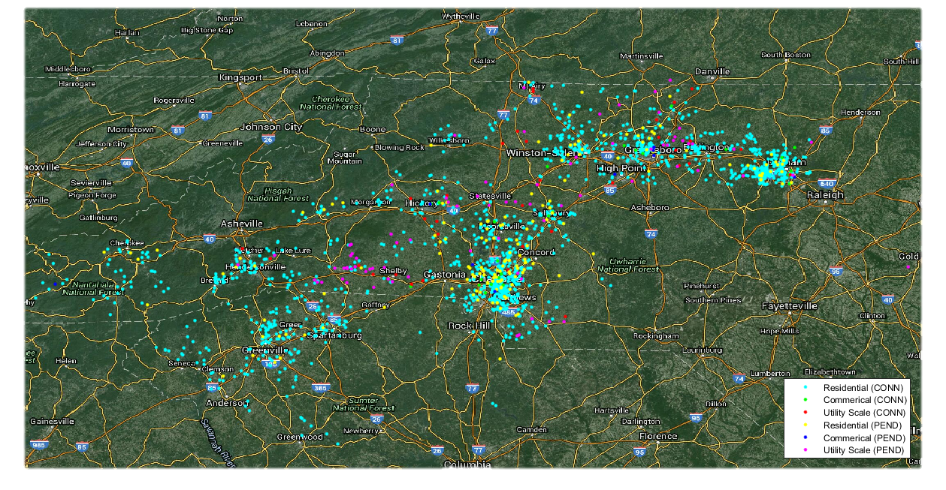
PV Interconnection Requests Locations

Slide 5
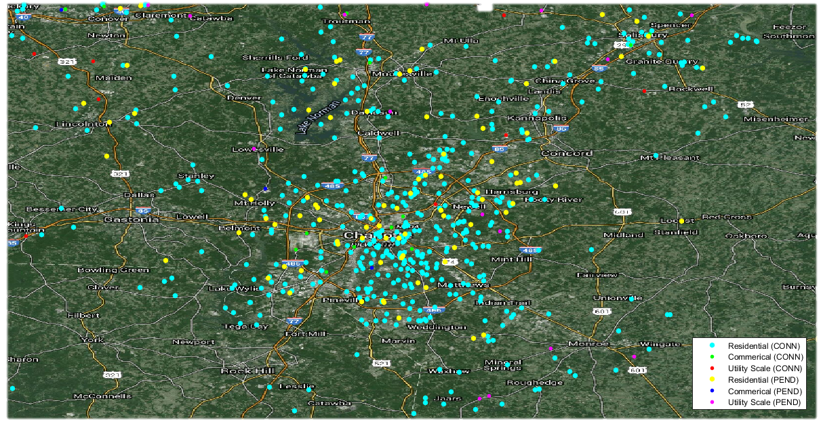
Charlotte Area

Slide 6
PV Interconnection Requests Locations

Slide 7
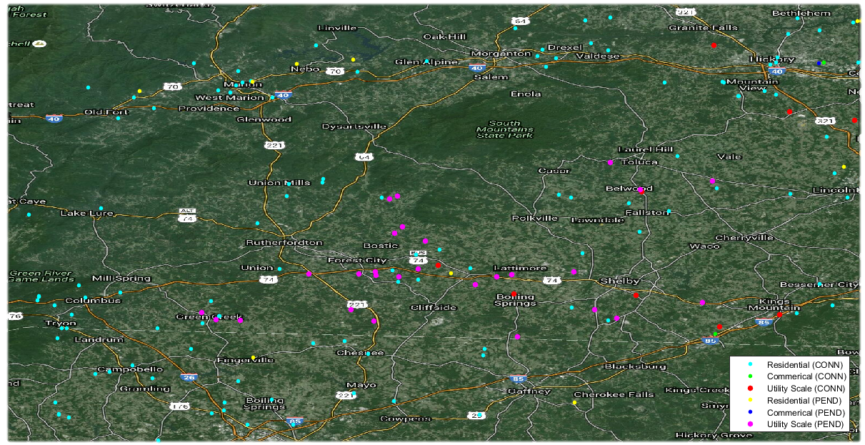
Area with Smaller Population

Slide 8
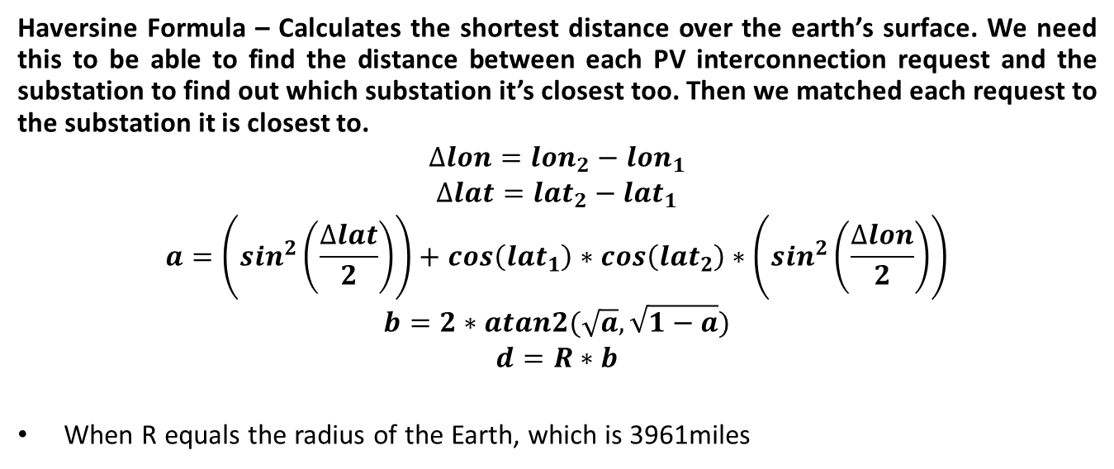
Distance Formula
Haversine Formula – Calculates the shortest distance over the earth’s surface. We need this to be able to find the distance between each PV interconnection request and the substation to find out which substation it’s closest too. Then we matched each request to the substation it is closest to.
$$∆lon={lon}_{2}−{lon}_{1}$$
$$∆lat={lat}_{2}−{lat}_{1}$$
$$a=\left(\sin^{2}\left(\frac{∆lat}{2}\right)\right)+cos\left({lat}_{1}\right)∗cos\left({lat}_{2}\right)∗\left(\sin^{2}\left(\frac{∆lon}{2}\right)\right)$$
$$b=2∗atan2(\sqrt{a},\sqrt{1−a})$$
$$d=R∗b$$
When R equals the radius of the Earth, which is 3961miles

Slide 9
Vicinity Approach
Substation | Feeder Number | Residential (Conn) | Commercial (Conn) | Utility (Conn) | Residential (Pend) | Commercial (Pend) | Utility (Pend)
1 | 1 | 75.01 KW | 0 | 0 | 0 | 0 | 0
2 | 2 | 35.45 KW | 0 | 0 | 18.35 KW | 0 | 0
3 | 3 | 16.4 KW | 0 | 0 | 0 | 0 | 5000 KW
4 | 7 | 5.36 KW | 0 | 10000 KW | 0 | 0 | 5000 KW
Substation | Feeder Number | Residential (Conn) | Commercial (Conn) | Utility (Conn) | Residential (Pend) | Commercial (Pend) | Utility (Pend)
1 | 1 | 75.01 KW | 0 | 0 | 0 | 0 | 0
2 | 2 | 35.45 KW | 0 | 0 | 18.35 KW | 0 | 0
3 | 3 | 16.4 KW | 0 | 0 | 0 | 0 | 5000 KW
4 | 7 | 5.36 KW | 0 | 10000 KW | 0 | 0 | 5000 KW
Substation 1 appears to only feature Residential connections with no other request
Where as Substation 2, 3, and 4 all feature some pending request and 3 and 4 both would have Utilities.

Slide 10
Substation 1
Substation 1 (Feeder 01)
Type | Connected | Pending
Residential | .272 MW | .107 MW
Commercial | .135 MW | .359 MW
Utility | 21.45 MW | 21.89 MW
Total | 21.87 MW | 22.35 MW
In this table we took Substation 1 with a 20 mile radius to show all PV interconnection requests.
All of the requests that are closest to a substation within a 20 mile radius of Substation 1 are summed together

Slide 11
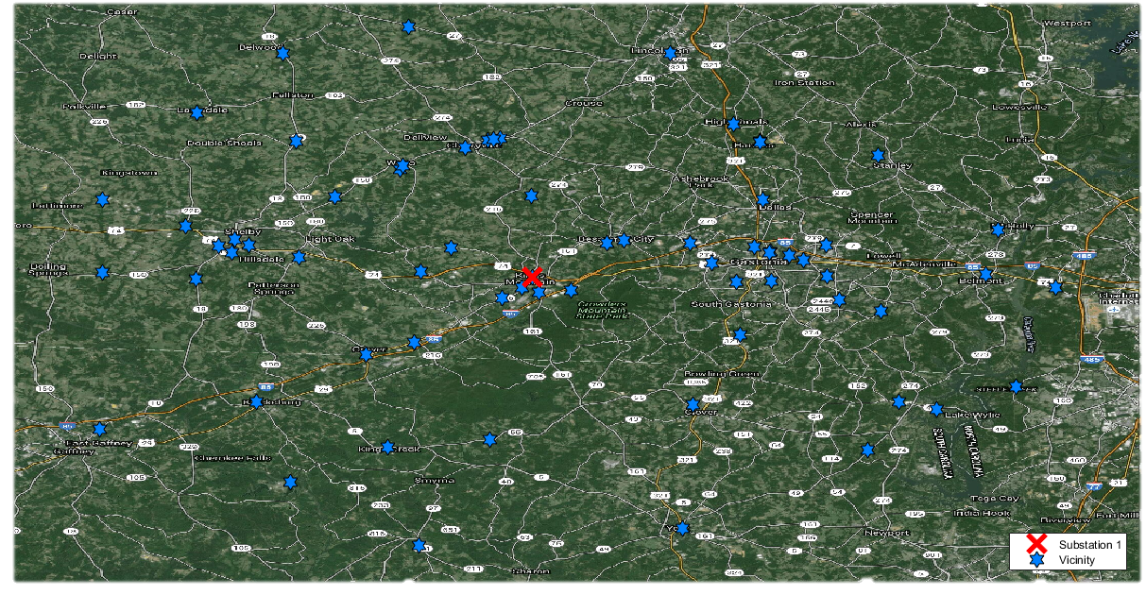
Vicinity of Substation 1

Slide 12
Total PV of West
Total in West
Type | Connected | Pending
Residential | 9.15 MW | 1.17 MW
Commercial | 5.44 MW | 2.28 MW
Utility | 140.1 MW | 288.8 MW
Total | 154.7 MW | 292.3 MW
In this table the total amount Power each type of request has in the Carolinas

Slide 13
Substation 1 Feeder 01
Type | Percentage
Residential | 5.0541%
Commercial | 10.7771%
Utility | 8.4158%
This percentage column in this table has a weight of 20% for connected and 80% pending since we are more interested in future connections.
Observe that commercial sized facilities are most probable being connected in the Substation 1 area.
This information can be used by Distribution Planners when projecting future DER-PV facility connections

Slide 14
Remarks/Future Research
We will find a better way of estimating the weighted total of the percentages for better projected values of future DER-PV penetration scenarios.
This better estimation of weighted total will be based off of many factors including; population of the area, available land, and the ratio of connected vs pending interconnection request.

